Slide 1
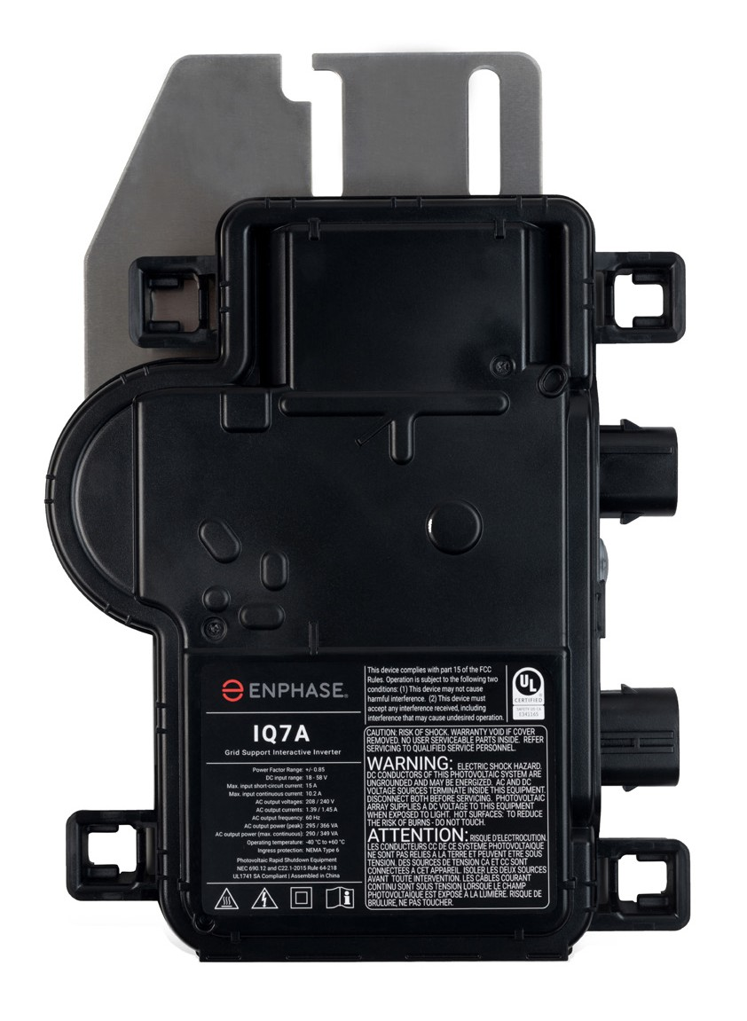
Meet the Enphase
IQ 7ATM Microinverter
The simplicity, reliability and safety of Enphase, now in a high power microinverter

Slide 2
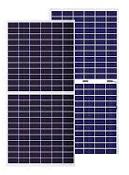
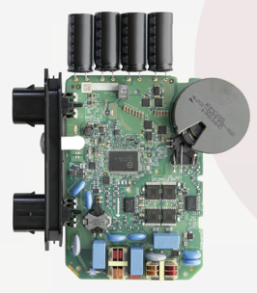
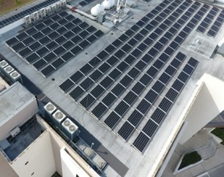
IQ 7A microinverter
IQ 7A-INT microinverter system
IQ7-based, technologically advanced, software-driven inverter architecture
Can Support Split cell and full cell PV modules
230V residential and commercial Applications
Uses state-of-the-art 2.8M million-gate Heron 3 ASIC
Enables even more flexible software upgrades to keep your system always new!
Supports 60 or 72 cell modules with full or split cell configurations
Easy to pair with high power commercial modules
Ideal for residential and commercial applications including malls, supermarkets, schools, fuel stations, hospitals

Slide 3
IQ 7A microinverter
IQ 7A specifications
IQ 7A Microinverter SKU: IQ7A-72-2-INT
Power rating` | 366W_{AC} peak
Modules Supported | Split or full cell 60 / 72 cell PV modules
AC output | 230V, single-phase, 50Hz
Operating temp | -40° C to 60° C
MPPT | Single
Monitoring | Per micro monitoring
IEC efficiency | 96.5%

Slide 4
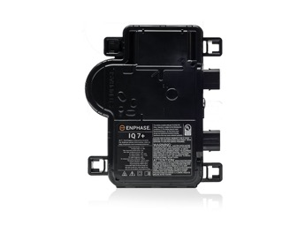
IQ 7A microinverter
Comparison between
IQ 7A and IQ 7+ system
 | IQ 7+ | IQ7A
Power, VA | 295, peak | 366, peak
Modules per inverter | 1 | 1
Phase | Single-phase | Single-phase
Service voltage | 230V | 230V
Weight | 1.08 kg | 1.08 kg
No. of modules per branch, 230V (/branch)* | 13 | 11
AC Cabling System | Q Cables | Q Cables
* 1.3 DC / AC Ratio

Slide 5
IQ 7A microinverter
Higher lifetime returns with Enphase IQ 7A microinverter
System Specifications | Enphase | MLPE Systems
Actual System Size (kW_{dc}) | 5 | 5
PV Module DC Peak Power (W_{dc}) | 400 | 400
No. of PV Modules | 13 | 13
Inverter Cost ($/Wdc) | $0.319 | $0.190
Rapid Shutdown Cost ($/Wdc) | $0.000 | $0.000
Lifetime ROI Breakdown | Enphase | MLPE | Delta
Initial Capital Expenditure | $1.280 | $1.231 | $0.050
NPV of System | $0.092 | $0.031 | $0.061
NPV of Total Output | $1.079 | $1.066 | $0.013
LCOE ($/kWh) | $0.0618 | $0.0795 | ($0.0177)
Note: Price considered here is ADLP

Slide 6
IQ 7A microinverter
Higher lifetime returns with Enphase IQ 7A microinverter
System Specifications | Enphase | MLPE Systems
Actual System Size (kW_{dc}) | 20 | 20
PV Module DC Peak Power (W_{dc}) | 400 | 400
No. of PV Modules | 50 | 50
Inverter Cost ($/Wdc) | $0.305 | $0.290
Rapid Shutdown Cost ($/Wdc) | $0.000 | $0.000
Lifetime ROI Breakdown | Enphase | MLPE | Delta
Initial Capital Expenditure | $1.280 | $1.231 | $0.050
NPV of System | $0.093 | $0.086 | $0.007
NPV of Total Output | $1.080 | $1.069 | $0.011
LCOE ($/kWh) | $0.0618 | $0.0649 | ($0.0031)
Note: Price considered here is ADLP

Slide 7
IQ7A: Resources
INTERNAL
IQ 7A-INT microinverter
France
Netherlands
UK
Germany
IQ 7A microinverter data sheet
Module Compatibility Calculator
Website
Website
Website
Website
Module Compatibility Calculator
Calculator
Calculator
Calculator
Calculator
OND Design File
LCOE
Simple UI
Complex UI

